Slide 1
OBJECT ORIENTED
ANALYSIS AND DESIGN
Ch - 11
Analysis Packages
A study material for the students of GLS University

Slide 2
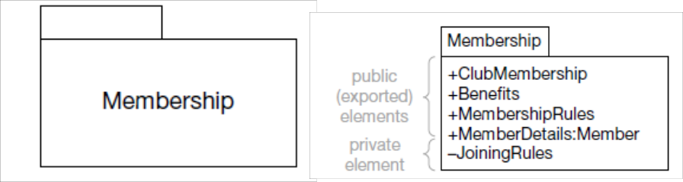
What is a package?
A Package is a folder in UML used to group related elements together.
Purpose of a Package:
To group related elements (like classes, diagrams, or components).
To create a semantic boundary (clear separation in model).
Helps in teamwork – allows multiple people to work in parallel.
Keeps names unique inside one package.
Example:
A Library System may have packages like Books, Users,

Slide 3
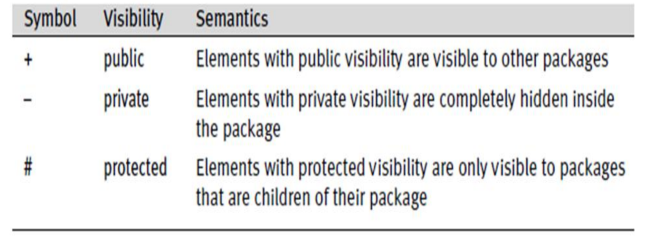
Package Syntax
A package looks like a folder icon.
The name of the package can appear on the tab or inside the folder.
You can give visibility to elements inside a package:

Slide 4
Packages and Namespaces
A Namespace is a space that defines a unique naming boundary.
Inside it, all element names must be unique.
Key Points:
Each package acts as a namespace.
If one package wants to use something from another package, it must use a qualified name (like a full path).
Example:
Library :: Users :: Librarian
→ means: the Librarian class is inside the Users package, which is inside Library.

Slide 5
Nested Packages
A Nested Package means one package inside another.
Features:
Packages can be nested to any level.
The inner (child) package can access elements from the outer (parent) package.
To access items in another nested package, you use the fully qualified name.
Example:
In package Library, you have a nested package Users with classes Librarian and Borrower.
So, to use them: Users::Librarian or Users::Borrower.

Slide 6
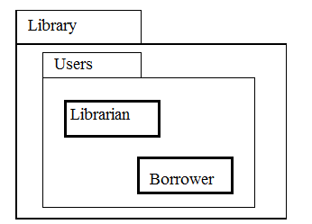
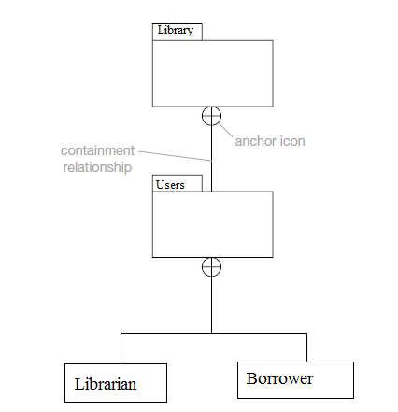
Nested Packages
An alternative nesting syntax:

Slide 7
Package Dependencies
A dependency means one package relies on another package for some elements.
There are four types of dependencies, each with a different meaning.
Common ones:
<<import>>
<<access>>

Slide 8
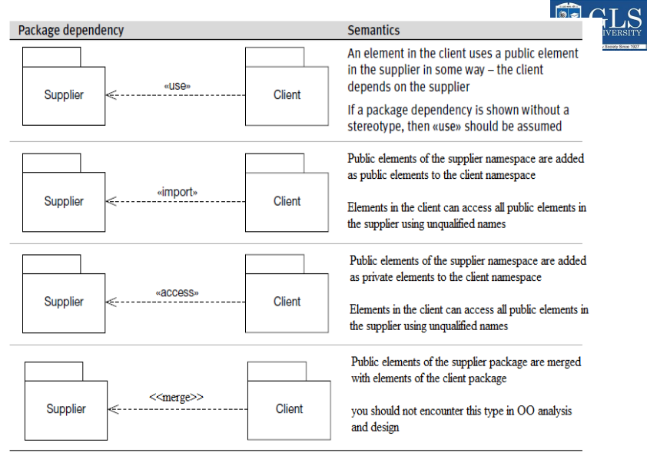

Slide 9
Import vs Access
Example:
If Package A imports Package B → A can use B’s public classes.
If A only accesses B → A can use them privately, not share further.
Type | Meaning | Visibility
<<import>> | Public merge : all public elements of supplier become public in client | Public
<<access>> | Private merge : supplier’s public elements become private in client | Private

Slide 10
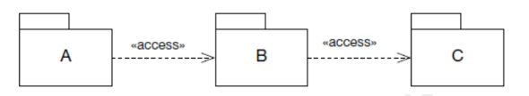
Transitivity
If A depends on B and B depends on C → then A indirectly depends on C.
Key Points:
<<import>> is transitive
<<access>> is not transitive
Example:
If A imports B and B imports C → A can see C.
But if A accesses B and B accesses C → A cannot see C.
This helps control coupling (connections) between packages.

Slide 11
Managing Access
Public elements in Package C → become private in Package B
Public elements in Package B → become private in Package A
Hence, A can’t see elements of C directly.
This rule helps to control access and keep the system organized and secure

Slide 12
Package Generalization
Package Generalization means one package (child) inherits from another package (parent).
The child package gets all public and protected elements of its parent.
It can add new elements or override existing ones.
Example:
Parent Package → Product
Child Packages → Hotels, CarHire
Both inherit items from Product.
Hotels adds Hotel and RoomType classes.
CarHire adds a Car class.
Both override the Item class from the parent.

Slide 13
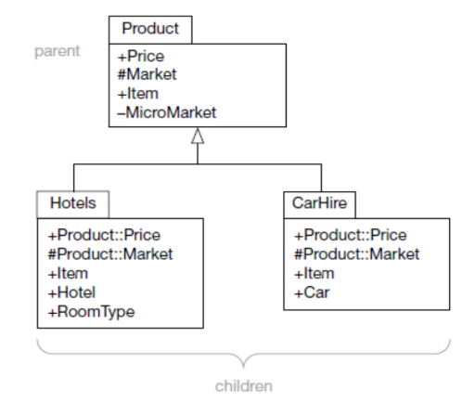
Package Generalization

Slide 17
THANK YOU

